Slide 1
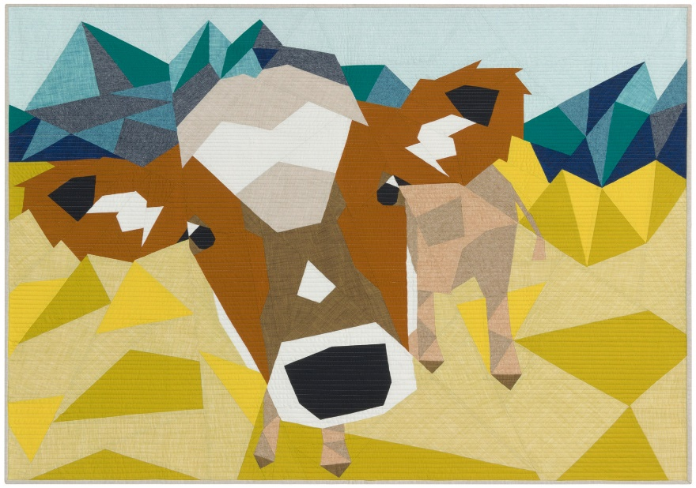
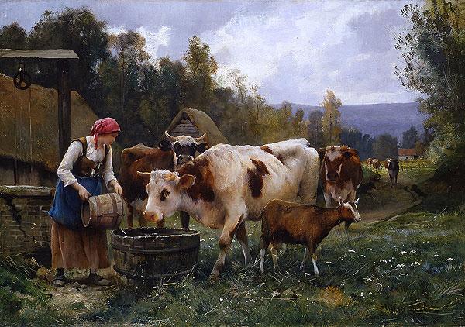
Introduction to R Programming and Collaborative Science
Pranav Pandit
BVSc & AH, MPVM, PhD
Department of Population Health and Reproduction, School of Veterinary Medicine, UC Davis
Slides Courtesy: Dr. Nistara Randhawa

Slide 2
Learning Objectives
Introduction to R Programming
Basics of R syntax and data types
Project management
Setting up Jupyter and Anaconda Environments
Collaborative and Reproducible Science
Best Practices for collaborative research and reproducibility

Slide 3
Data is valuable
Great effort is put in to collect data systematically
Hard work, meticulous planning, and recourses are put in to collect the data

Slide 4
Data management
For safe storage and sharing
Generating reproducible research

Slide 5

Collaborate effectively
Colleagues
You
Future you

Slide 6
Data management
Organize your project folder
Protect your raw data
Name your files effectively
Track your project’s changes
Backup your project

Slide 7
Project folder
AnimalsSampled_Export_May16_0438.csv Site_Exoort_May18_2353.csv

Slide 8
Protect your raw data
Do not edit raw data directly
Copy and worn with it so the original data is not modified

Slide 9
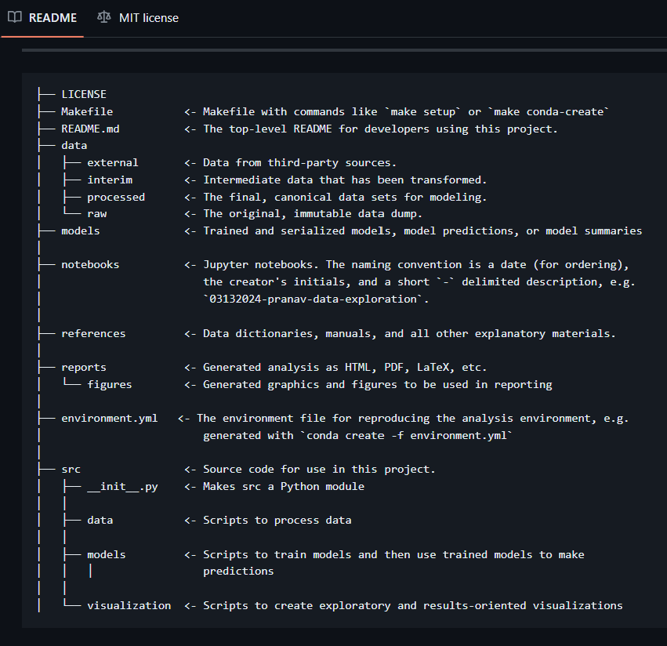
Version Control you data and code
Git: https://github.com/
Drive/Box/Dropbox
Local external hard-disk

Slide 10
Naming files
Descriptive
Consistent
Human readable
Machine readable

Slide 11
RStudio

Slide 12
RStudio

Slide 13
RStudio

Slide 14
Important data management and wrangling concepts in R
Refer to the code demonstration
“Introduction to R.html”

